Slide 1

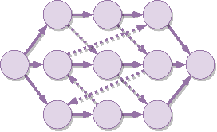




Learning to Dispatch for Job Shop Scheduling via Deep Reinforcement Learning
Cong Zhang¹, Wen Song², Zhiguang Cao³, Jie Zhang¹, Puay Siew Tan⁴, and Chi Xu⁴
¹Nanyang Technological University
²Institute of Marine Science and Technology, Shandong University, China
³National University of Singapore
⁴Singapore Institute of Manufacturing Technology, A*STAR

Slide 2
Background
Learning to dispatch (L2D)
Experiment
Conclusion
CONTENTS

Slide 3
Background
Learning to dispatch (L2D)
Experiment
Conclusion
CONTENTS

Slide 4


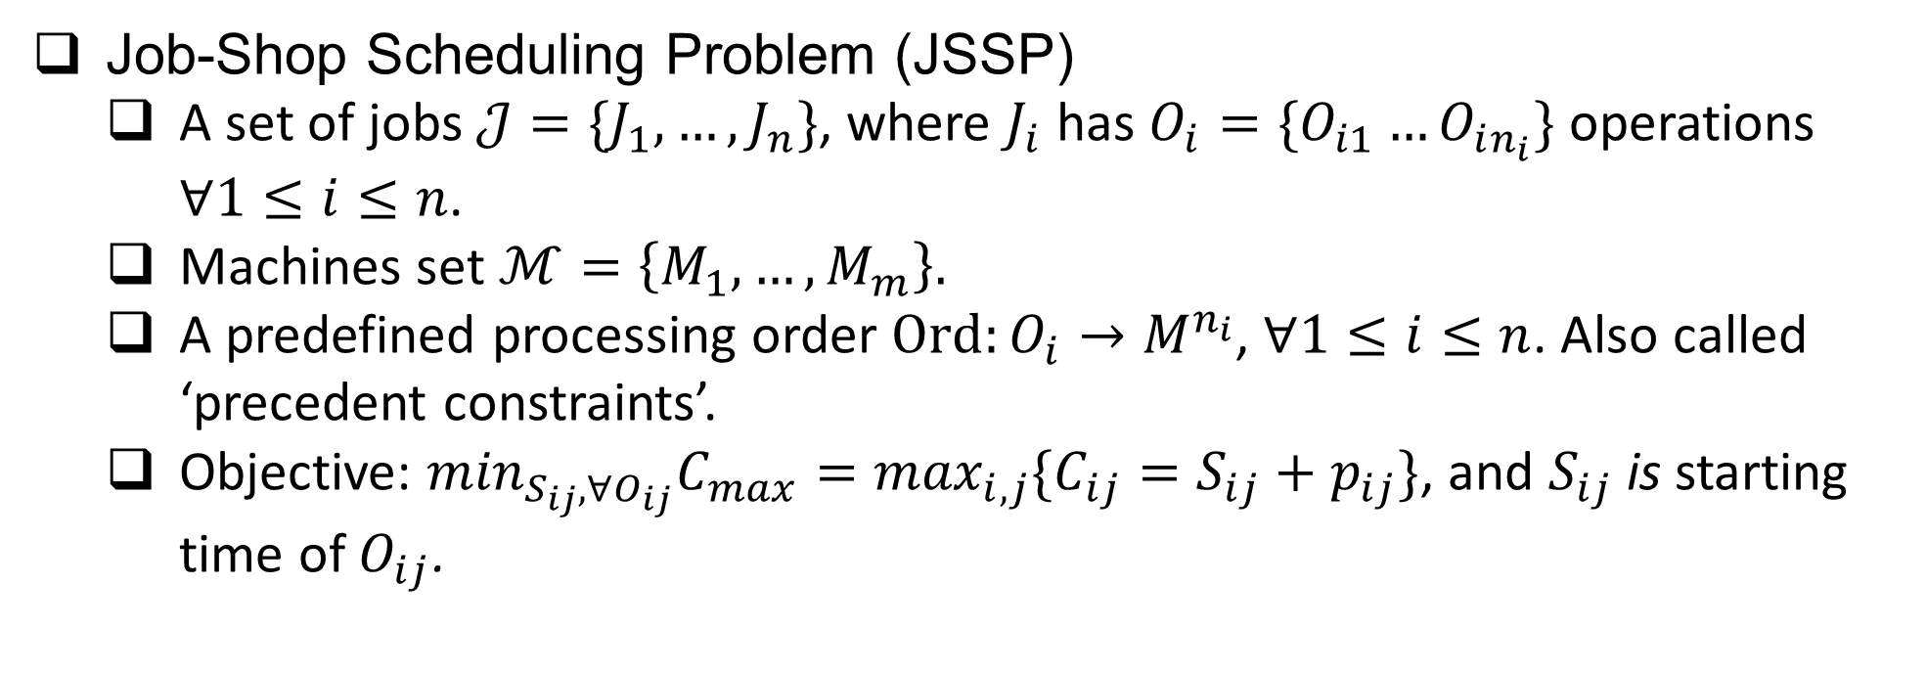
1
Background
Job-Shop Scheduling Problem & Disjunctive Graphs
Job-Shop Scheduling Problem (JSSP)
A set of jobs$𝒥=\{J_{1}, …, J_{n}\}$, where $J_{i}$ has $O_{i}=\{O_{i1}…O_{in_{i}}\}$ operations $∀1≤i≤n$.
Machines set $ℳ=\left\{M_{1}, …, M_{m}\right\}.$
A predefined processing order $Ord:O_{i}→M^{n_{i}}$, $∀1≤i≤n$. Also called ‘precedent constraints’.
Objective: $\min_{S_{ij}, ∀O_{ij}}C_{max}=\max_{i,j}\{C_{ij}=S_{ij}+p_{ij}\}$, and $S_{ij}$ is starting time of $O_{ij}$.

Slide 5
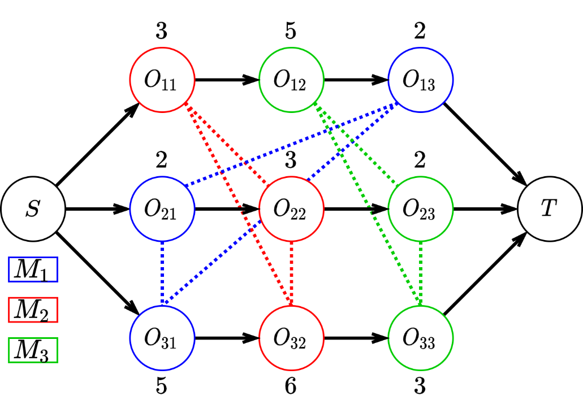
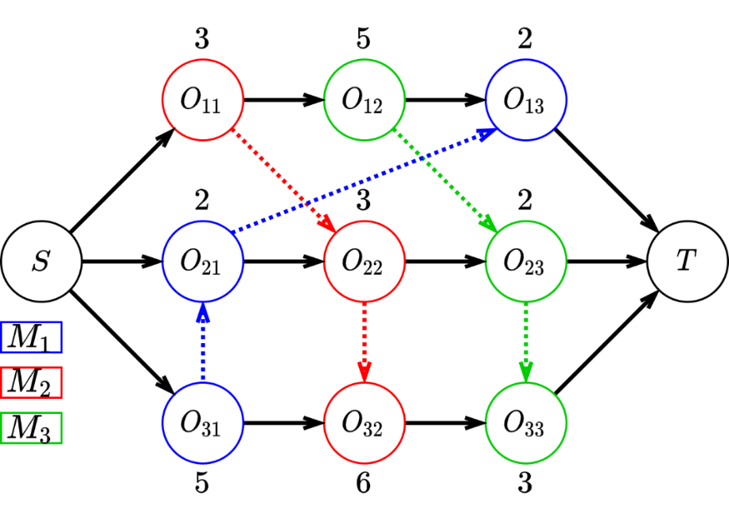
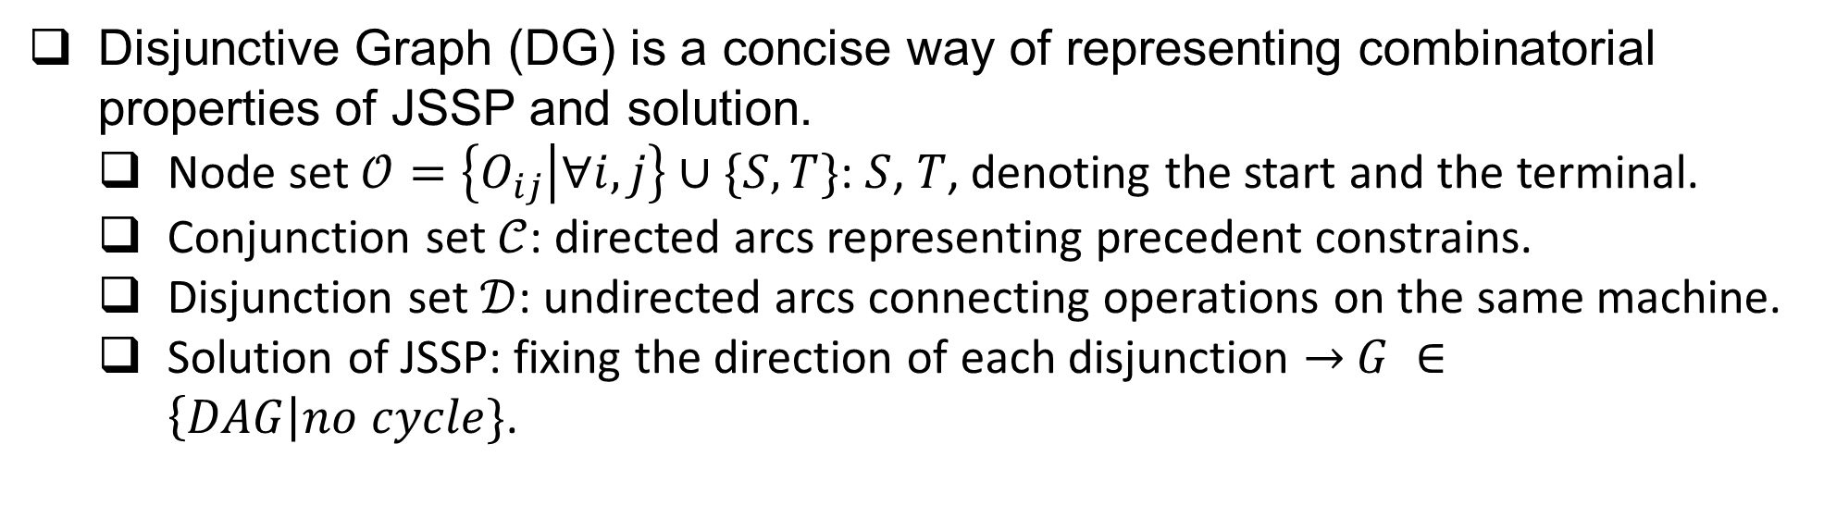
1
Background
Job-Shop Scheduling Problem & Disjunctive Graphs
Disjunctive Graph (DG) is a concise way of representing combinatorial properties of JSSP and solution.
Node set $𝒪=\left\{O_{ij} | ∀i,j\right\}∪\{S, T\}$: $S$, $T$, denoting the start and the terminal.
Conjunction set $𝒞$: directed arcs representing precedent constrains.
Disjunction set $𝒟$: undirected arcs connecting operations on the same machine.
Solution of JSSP: fixing the direction of each disjunction $→$ $G ∈\left\{DAG\right|no cycle\}$.
Conjunction
Disjunction
(a) JSSP instance
(b) Complete Solution

Slide 6
1
Background
Motivation
Priority Dispatching Rule (PDR) is a class of heuristics that is widely used to solve real-world JSSP:
Based on some calculated priority indices, it dispatches and schedules, within the current waiting list, the operation with highest index.
However, the design of effective PDRs is a tedious task:
Requiring a myriad of specialized knowledge;
Delicate and limited performance for different JSSPs;
Q: How to search the PDR space automatically to find PDR that has robust generalization and strong performance?
Notes:
asdasda

Slide 7

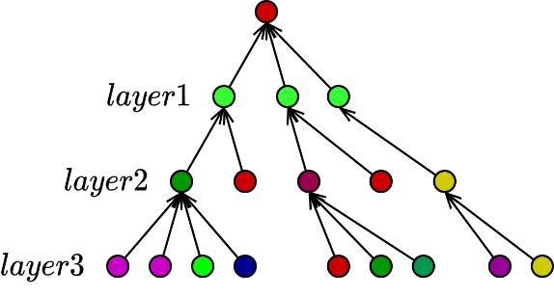
1
L2D
Challenges
Challenges
Due to strong NP-hardness, how to search the PDR space efficiently and effectively in an end-to-end & un-supervised manner?
Can learning be size-agnostic so that learned PDR would generalize to un-seen large-scale instances?
Graph Neural Networks
+
Learning to Dispatch

Slide 8
Background
Learning to dispatch (L2D)
Experiment
Conclusion
CONTENTS

Slide 9




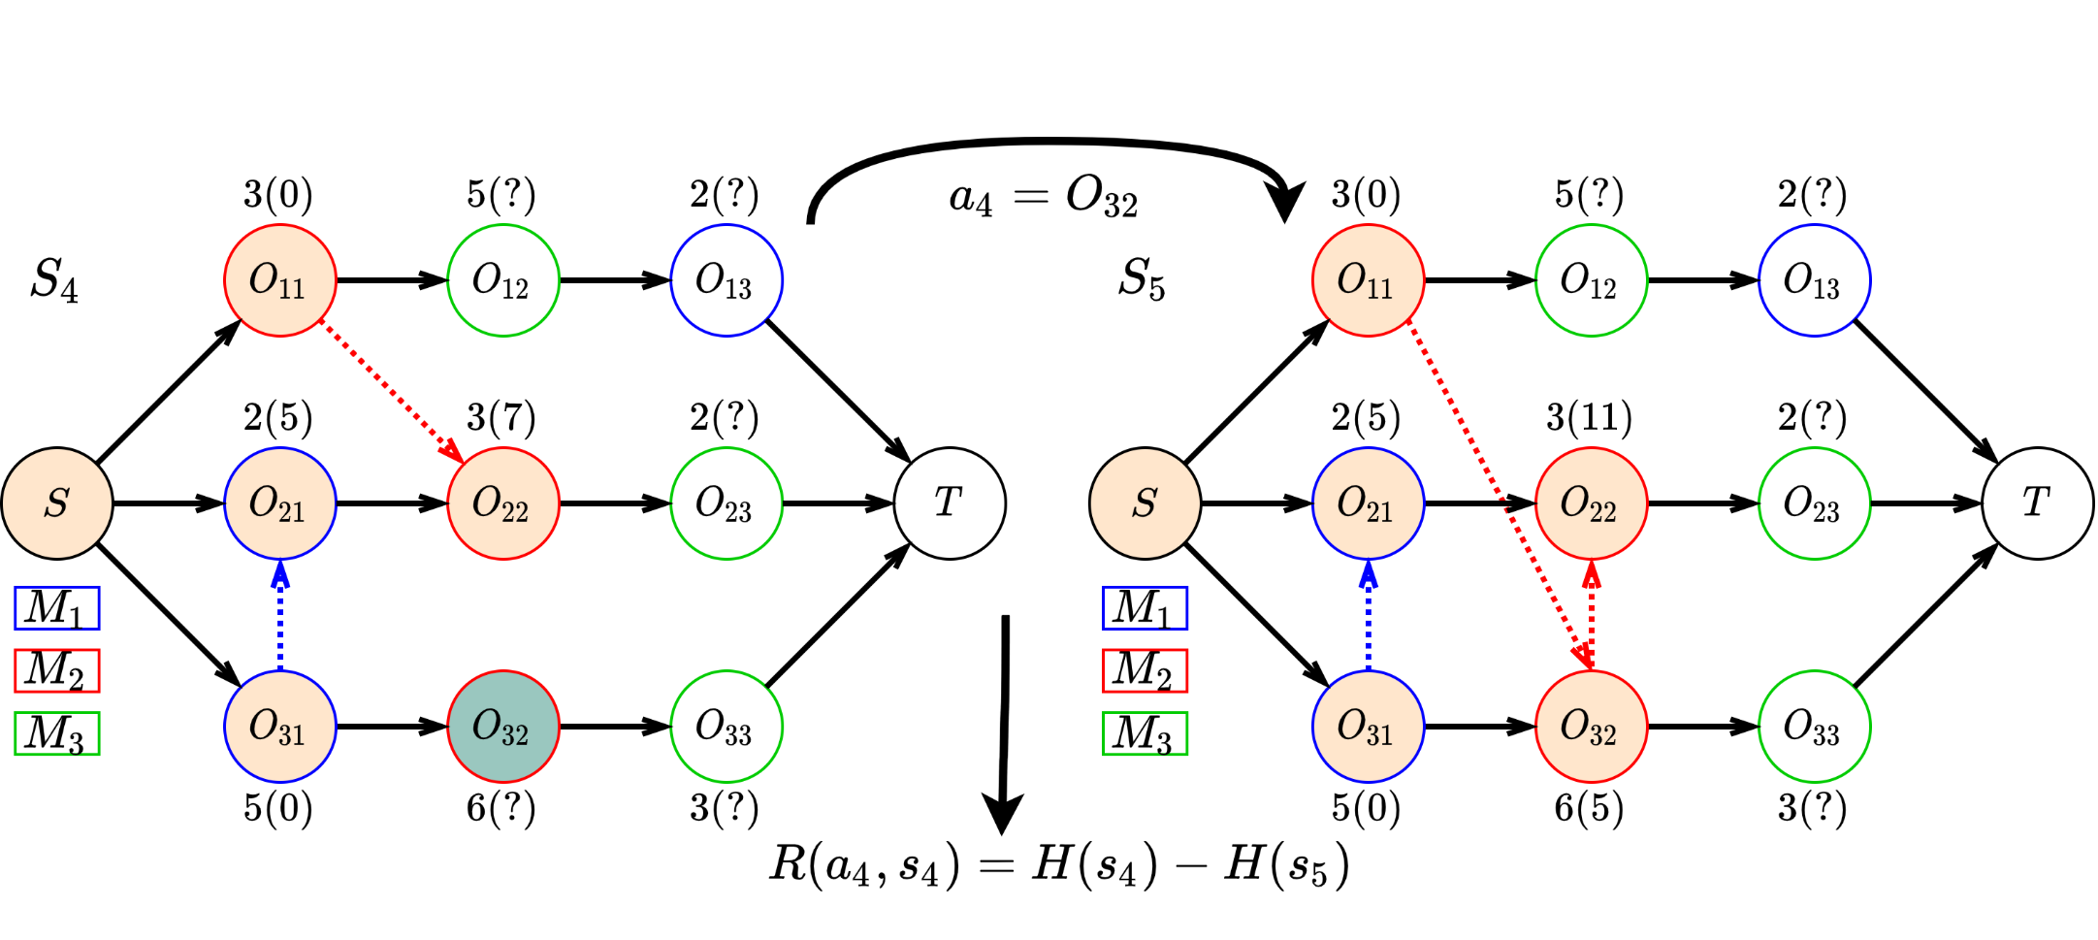
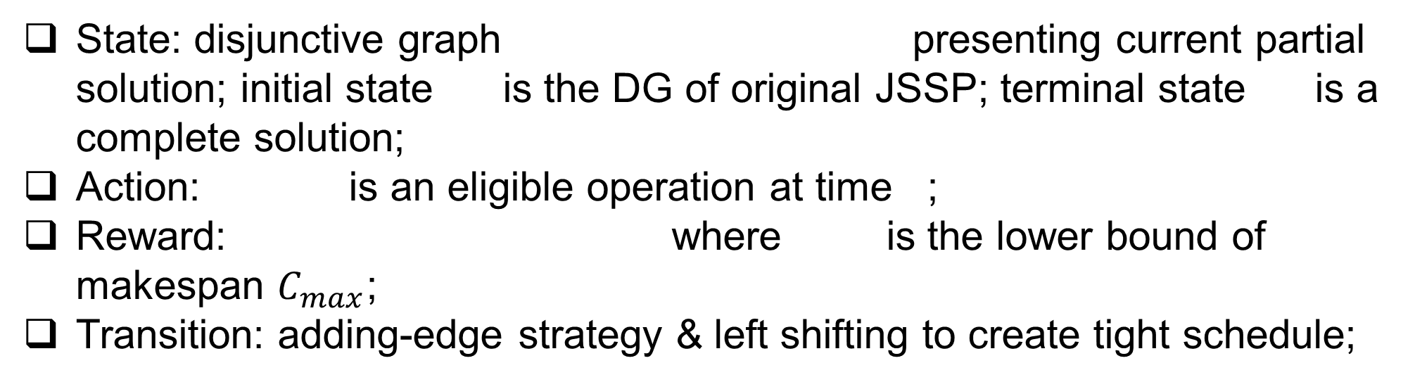
2
L2D
Markov Decision Process Formulation
State: disjunctive graph presenting current partial solution; initial state is the DG of original JSSP; terminal state is a complete solution;
Action: is an eligible operation at time ;
Reward: where is the lower bound of makespan $C_{max}$;
Transition: adding-edge strategy & left shifting to create tight schedule;

Slide 10
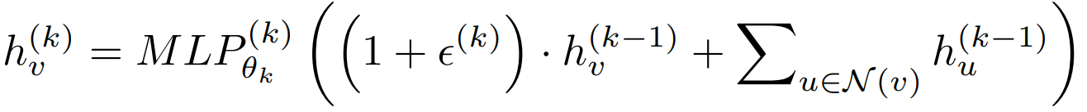
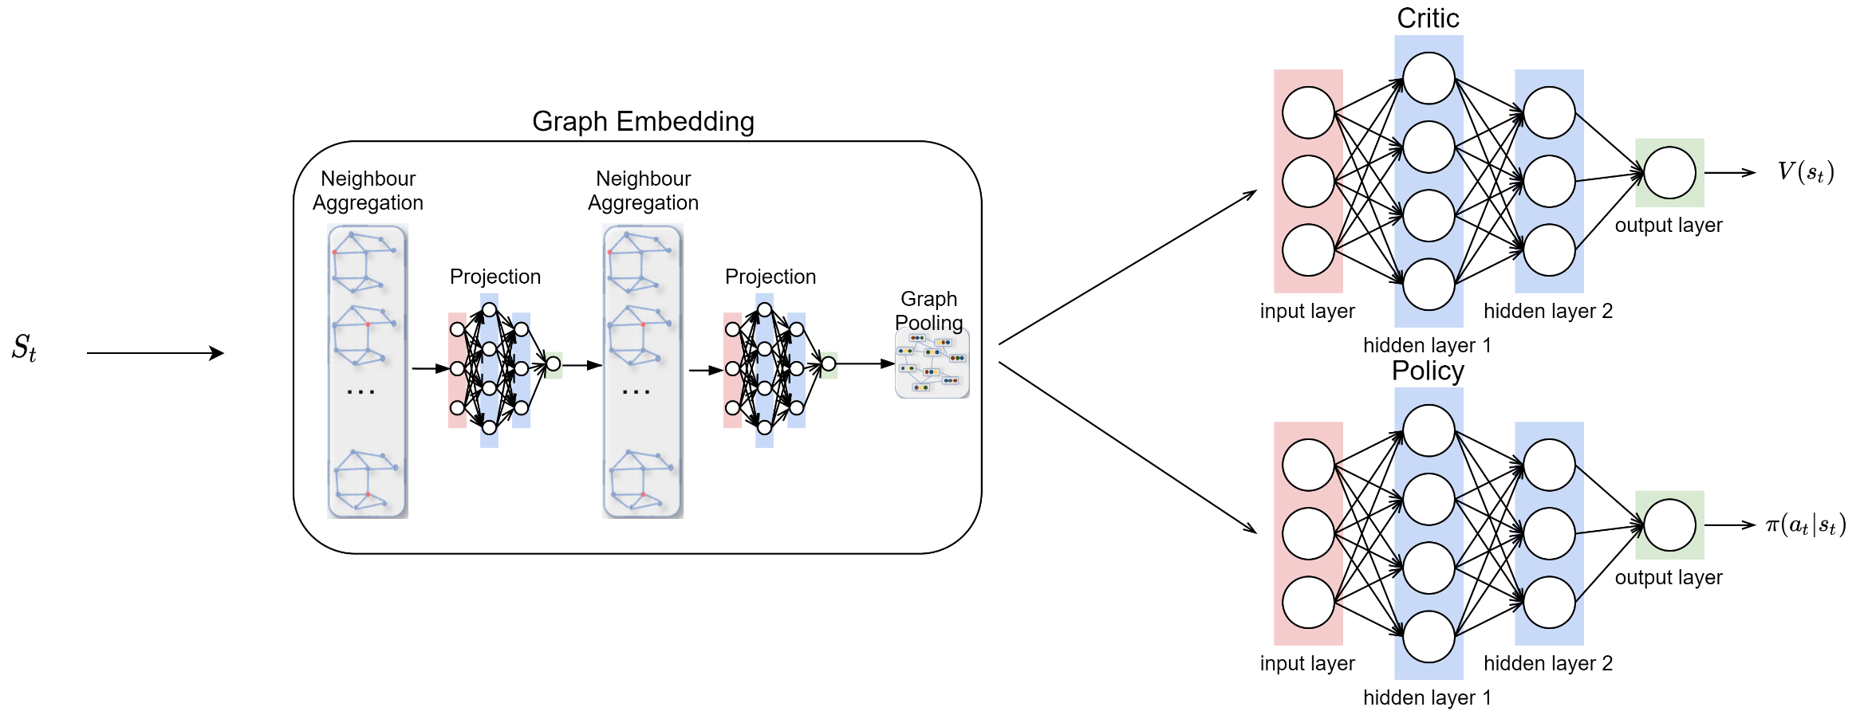
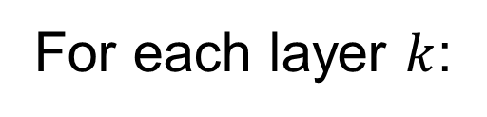
2
L2D
Parameterizing the Policy
We use GIN as state embedding network as it is one of the strongest GNN for homogeneous graphs with proved discriminative power.
For each layer $k$:
Actor-Critic Architecture

Slide 11
Background
Learning to dispatch (L2D)
Experiment
Conclusion
CONTENTS

Slide 12
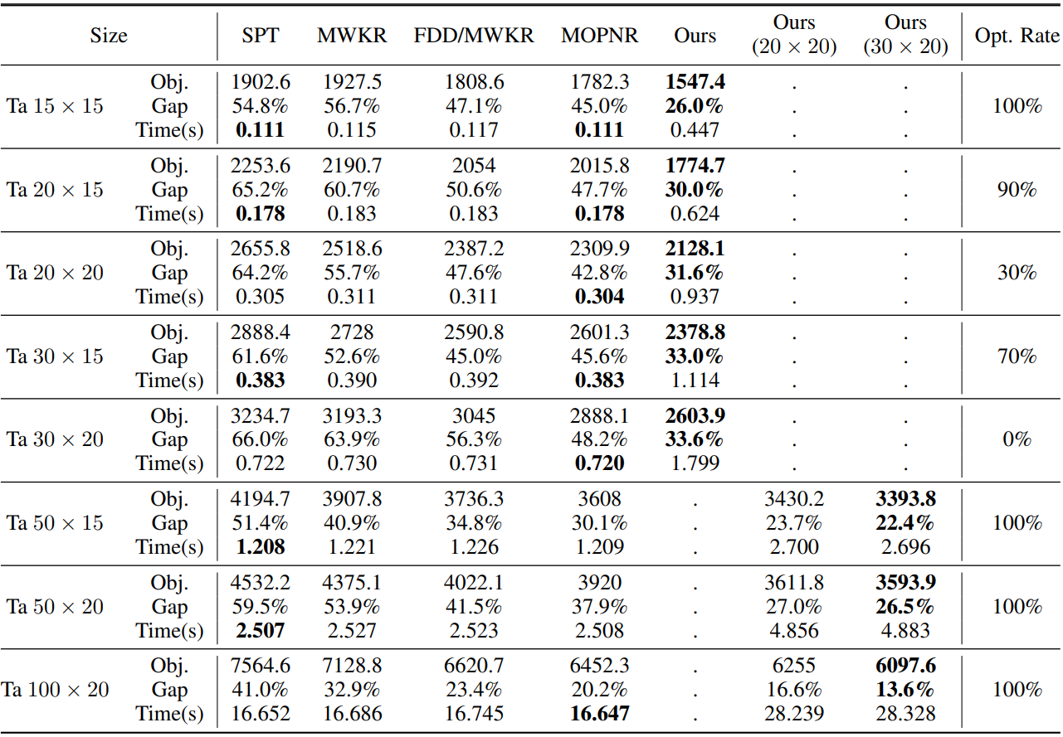
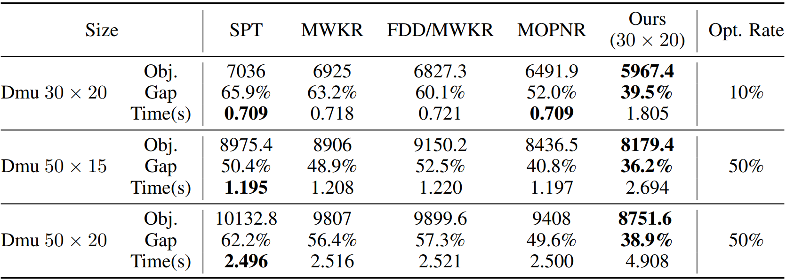
3
Experiment
Datasets & Baselines & Result
Training algorithm: Proximal Policy Optimization (PPO).
Datasets: Synthetic dataset, Taillard’s instances (open benchmark), DMU instances(open benchmark).
Baselines: 4 existing strongest PDRs: SPT, MWKR, FDD/MWKR, MOPNR.
Result: strong performance and good generalization. Only result for Taillard and DMU are showed
Generalization
DMU instances
Generalization
Taillard’s instances

Slide 13
Background
Learning to dispatch (L2D)
Experiment
Conclusion
CONTENTS

Slide 14
4
Conclusions
It is the first attempt to directly learn strong PDRs based on disjunctive graph representation.
Learned PDR has robust generalization.
Thank you !

